Slide 1


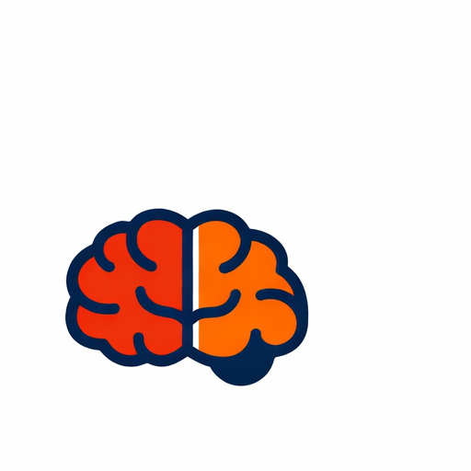


VEAMOS, ENTENDAMOS, APRENDAMOS
A visual–practical key to Spanish grammar
See the rule
Visual structure at a glance
Understand it
Clear, step-by-step logic
Visual rules + practical examples
Designed for quick review and long-term retention.
Use it confidently
Concrete practical examples
The “Static Video” method
Video-like clarity · book-like searchability
Veamos, entendamos, aprendamos
1
Notes:
[Sources]
- Icons: Font Awesome Free (https://fontawesome.com).
[/Sources]

Slide 2

The challenge today: distraction
So many things compete for our attention
Notifications, social media, streaming and games all pull us away from focused study.
This can make language learning feel slower and more tiring than it should be.
Learners need clarity in small, manageable steps.
They also need a format that is easy to revisit.
Veamos, entendamos, aprendamos
2
Notes:
[AltText]
Illustration of devices and entertainment competing for attention.
[/AltText][Sources]
- Image: Provided by client in original deck (Presentacion del libro Ilustrativa EN.pptx).
[/Sources]

Slide 3

Why traditional methods feel harder
Dense explanations can overwhelm
Long grammar explanations and heavy textbooks often demand more concentration than learners can sustain.
Motivation drops when progress feels slow.
Learners may avoid grammar and rely on guessing.
Veamos, entendamos, aprendamos
3
Notes:
[AltText]
Student overwhelmed by study materials and social media icons.
[/AltText][Sources]
- Image: Provided by client in original deck (Presentacion del libro Ilustrativa EN.pptx).
[/Sources]

Slide 4

Why videos are popular
Video lessons feel easier to follow
Many people prefer video lessons to textbooks and grammar manuals.
They are engaging and easy to start.
They work well for short study sessions.
Veamos, entendamos, aprendamos
4
Notes:
[AltText]
Online video lesson illustration with play button and books.
[/AltText][Sources]
- Image: Provided by client in original deck (Presentacion del libro Ilustrativa EN.pptx).
[/Sources]

Slide 5

The problem with videos
It’s hard to look things up
A major drawback of video lessons is that it is difficult to locate one specific rule or example.
Rewinding and hunting wastes time.
It’s hard to find exactly what you need in the moment.
Veamos, entendamos, aprendamos
5
Notes:
[AltText]
Collage image symbolizing memory and searching for information.
[/AltText][Sources]
- Image: Provided by client in original deck (Presentacion del libro Ilustrativa EN.pptx).
[/Sources]

Slide 6

An innovative solution
The “Static Video” method
A study guide that keeps the clarity of video learning — while remaining easy to scan and search like a book.
See the rule at a glance.
Get a concrete practical example.
Return to any topic instantly.
Veamos, entendamos, aprendamos
6
Notes:
[AltText]
Lightbulb growing from a plant pot, symbolizing an idea that grows.
[/AltText][Sources]
- Image: Provided by client in original deck (Presentacion del libro Ilustrativa EN.pptx).
[/Sources]

Slide 7

Who is the author?
A teacher with long classroom experience
Method built through practice
The method is based on years of teaching practice and real student questions.
Teaching experience
40+ years
Continuous refinement
Over 40 years of experience teaching Spanish.
Worked with learners of different ages and backgrounds.
Focus on clarity, confidence, and practical usage.
8+ years
Practical focus
Rule → example
Veamos, entendamos, aprendamos
7
Notes:
[Sources]
- Icons: Font Awesome Free (https://fontawesome.com).
[/Sources]

Slide 8

Best of both worlds
Video-like learning + book-like control
The approach combines the advantages of video learning and traditional teaching materials.
Engaging and visual.
Structured and easy to review.
Fast to navigate and repeat.
Veamos, entendamos, aprendamos
8
Notes:
[AltText]
Hands holding interlocking gears, symbolizing combining methods.
[/AltText][Sources]
- Image: Provided by client in original deck (Presentacion del libro Ilustrativa EN.pptx).
[/Sources]

Slide 9

A key insight
When you can “see” grammar, it clicks
A clear visual structure turns abstract rules into patterns you can recognize and reuse.
Less memorization-by-force.
More understanding of how sentences are built.
Faster recall when speaking or writing.
Veamos, entendamos, aprendamos
9
Notes:
[AltText]
Learner thinking with connected icons around a lightbulb.
[/AltText][Sources]
- Image: Provided by client in original deck (Presentacion del libro Ilustrativa EN.pptx).
[/Sources]

Slide 10

Tested and refined
Built through real teaching
The “Static Video” was tested for more than eight years and continuously improved while working with numerous students.
Refined through feedback.
Improved for clarity and speed.
Optimized for real learner needs.
Veamos, entendamos, aprendamos
10
Notes:
[AltText]
Illustration of learners supported by hands, symbolizing guided learning and community.
[/AltText][Sources]
- Image: Provided by client in original deck (Presentacion del libro Ilustrativa EN.pptx).
[/Sources]

Slide 11

Why it’s easier to remember
Logical + associative thinking
See → Apply → Remember
Each grammar rule is presented through visualization and a concrete practical example.
This activates both logical and associative thinking, making the material easier to understand and remember.
Visual pattern
Rule shown as a structure
Concrete example
See it → understand it.
Apply it → retain it.
Review fast whenever you need.
Rule in real usage
Memory links
Connections form faster
Veamos, entendamos, aprendamos
11
Notes:
[Sources]
- Icons: Font Awesome Free (https://fontawesome.com).
[/Sources]

